Slide 1
18AE2045 Basics of Aerospace Engineering
Satellites – Classification and Applications
G. Jims John Wessley

Slide 2
OUTLINE
Introduction
Types of Satellites

Slide 3
1. INTRODUCTION
A satellite is a moon, planet or machine that orbits a planet or star
Example, Earth is a satellite because it orbits the sun, moon is a satellite because it orbits Earth
"satellite" refers to a machine that is launched into space and moves around Earth or another body in space

Slide 4
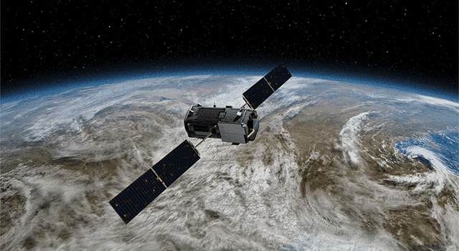
1. INTRODUCTION

Slide 5
1. INTRODUCTION
The bird's-eye view that satellites have allows them to see large areas of Earth at one time
Ability to collect more data, more quickly, than instruments on the ground

Slide 6
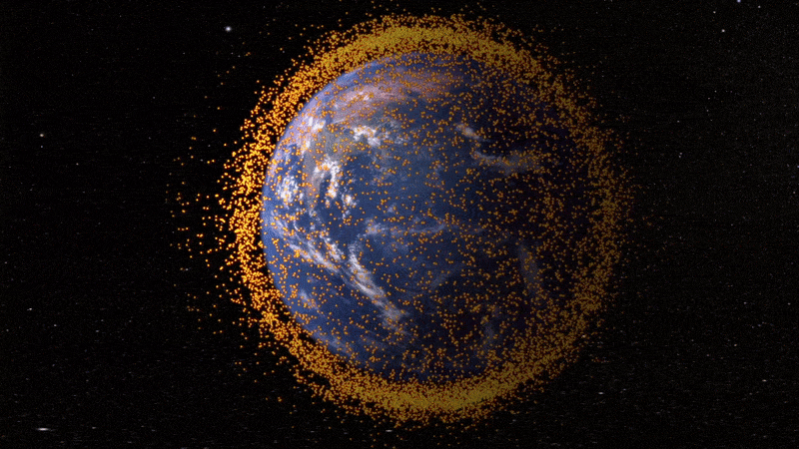
1. INTRODUCTION
Satellites can see space better than telescopes at Earth's surface
Satellites fly above the clouds, dust and molecules in the atmosphere that can block the view from ground level

Slide 7
1. INTRODUCTION
Satellites can be classified by their function -launched into space to do a specific job
Satellite that is launched to monitor cloud patterns for a weather station will be different than a satellite launched to send television signals

Slide 8
2. TYPES OF SATELLITES
Astronomy Satellites
Atmospheric studies Satellites
Communication Satellites
Navigation Satellites
Reconnaissance Satellites
Remote sensing Satellites
Search and Rescue Satellites
Space Exploration Satellites
Weather Satellites

Slide 9
2. TYPES OF SATELLITES
Astronomy Satellites
An astronomy satellite is a really big telescope floating in space
Because it is in orbit above the Earth, Astronomy satellites can "see" into space up to ten times better than a telescope of similar strength on Earth

Slide 10
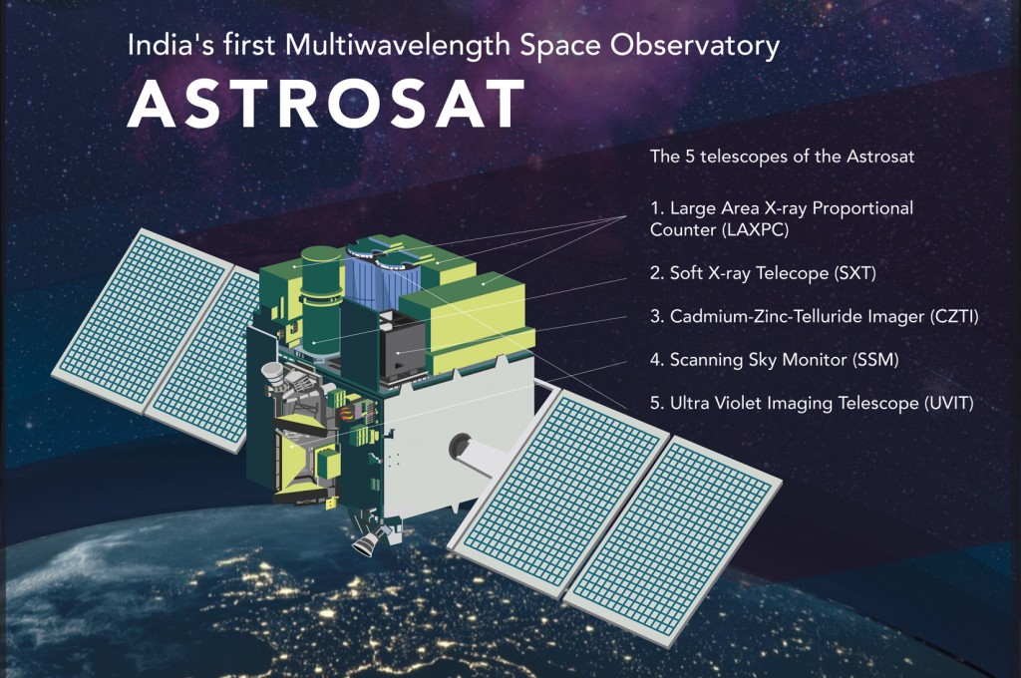
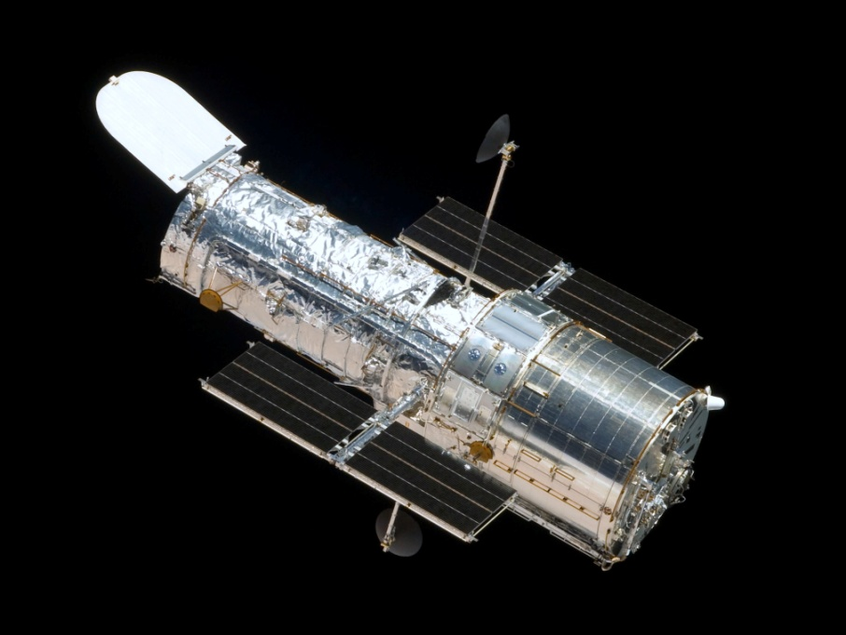
2. TYPES OF SATELLITES
Astronomy Satellites
ASTROSAT
Hubble Telescope

Slide 11
2. TYPES OF SATELLITES
Astronomy Satellites
Applications :
Used to make star maps
Used to study mysterious phenomena such as black holes
Used to take pictures of the planets in the solar system
Used to make maps of different planetary surfaces

Slide 12
2. TYPES OF SATELLITES
2. Atmospheric Studies
Atmospheric studies satellites were some of the very first satellites launched into space
They are low Earth orbits so that they can study the Earth's atmosphere

Slide 13
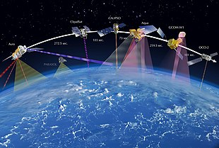
2. TYPES OF SATELLITES
2. Atmospheric Studies
Non-military uses such as environmental monitoring, meteorology, cartography

Slide 14
2. TYPES OF SATELLITES
2. Atmospheric Studies
Applications :
Weather Monitoring
Environmental Monitoring
Mapping

Slide 15
2. TYPES OF SATELLITES
3. Communication Satellites
Radio, television, and telephone transmissions anywhere in the world
Before satellites, transmissions were difficult or impossible at long distances

Slide 16
2. TYPES OF SATELLITES
3. Communication Satellites
The signals, which travel in straight lines, could not bend around the round Earth to reach a destination far away
Because satellites are in orbit, the signals can be sent instantaneously

Slide 17
2. TYPES OF SATELLITES
3. Communication Satellites
Communication by bouncing signals from the Earth back to another location on the Earth
Transponders for receiving, amplifying, and re-broadcasting

Slide 18
2. TYPES OF SATELLITES
3. Communication Satellites
Geostationary orbit (35,800 kilometers)
Orbits the Earth in the same amount of time it takes the Earth to revolve once the satellite appears to be stationary
Area transmitted - satellite's footprint

Slide 19
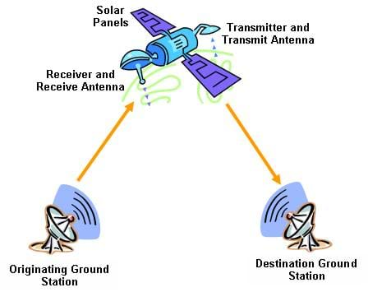
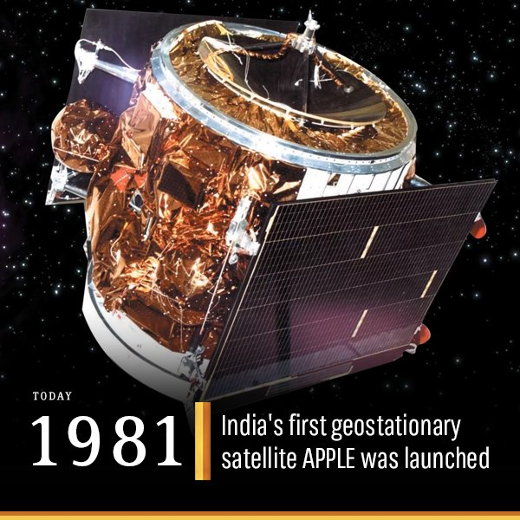
2. TYPES OF SATELLITES
3. Communication Satellites

Slide 20
2. TYPES OF SATELLITES
3. Communication Satellites
Applications :
Mobile phone signals
Weather tracking
Broadcasting television programs

Slide 21
2. TYPES OF SATELLITES
4. Navigation Satellites
Satellites provide the basis for all-weather, long-term navigation systems to determine geodetic position, speed, and direction, north reference, and vertical reference

Slide 22
2. TYPES OF SATELLITES
4. Navigation Satellites
Satellite Navigation is based on a global network of satellites that transmit radio signals in medium earth orbit

Slide 23
2. TYPES OF SATELLITES
4. Navigation Satellites
United States developed and operates GPS
7.8 meter accuracy, 95% of the time, anywhere on or near the surface of the earth
Russia, GLONASS & India - NavIC

Slide 24
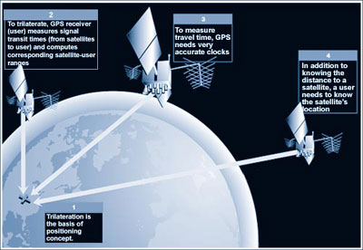
2. TYPES OF SATELLITES
4. Navigation Satellites

Slide 25
2. TYPES OF SATELLITES
5. Reconnaissance Satellites
Used to spy on other countries
Provide intelligence information on the military activities of other countries
Can detect missile launches or nuclear explosions in space

Slide 26
2. TYPES OF SATELLITES
5. Reconnaissance Satellites
Can pick up and record radio and radar transmissions while passing over a country
Can be used as an orbital weapon on a low orbit satellite to be launched

Slide 27
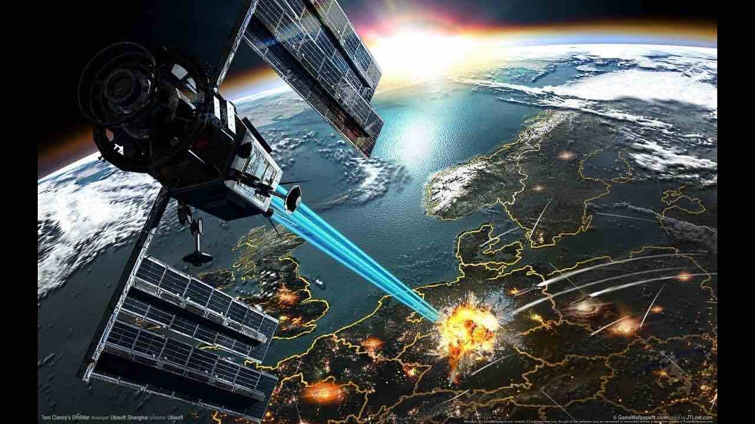
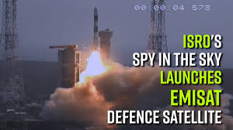
2. TYPES OF SATELLITES
5. Reconnaissance Satellites
April 2019

Slide 28
2. TYPES OF SATELLITES
6. Remote sensing Satellites
Observing and measuring our environment from a distance
Usually put into space to monitor resources important for humans

Slide 29
2. TYPES OF SATELLITES
6. Remote sensing Satellites
For ex : Track animal migration, locate mineral deposits, watch agricultural crops for weather damage, or see how fast the forests are being cut down
Photographs of large expanses

Slide 30
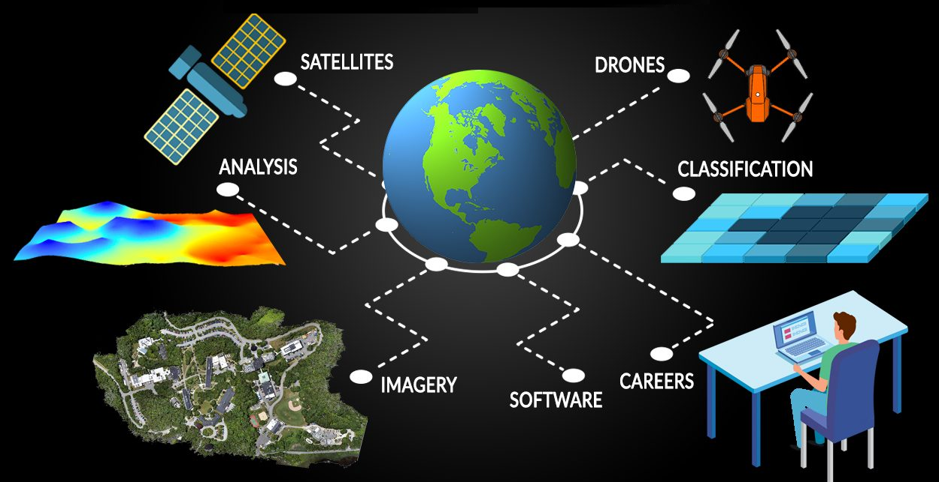
2. TYPES OF SATELLITES
6. Remote sensing Satellites

Slide 31
2. TYPES OF SATELLITES
7. Search and Rescue Satellites
Designed to provide a way for vessels at sea and in the air to communicate from remote areas
Detect and locate emergency beacons from ships, aircrafts or Individuals

Slide 32
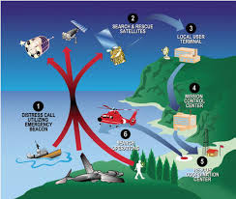
2. TYPES OF SATELLITES
7. Search and Rescue Satellites
INSAT-3A and INSAT-3D are equipped with a 406 MHz Search and Rescue payload that picks up and relays alert signals originating from the distress beacons of maritime, aviation and land users

Slide 33
2. TYPES OF SATELLITES
8. Space Exploration Satellites
Known as space probes
A satellite is defined as something that's orbiting something else, but space probes instead travel deep into the solar system

Slide 34
2. TYPES OF SATELLITES
8. Space Exploration Satellites
They are similar to orbiting satellites in design and function
Space probes send back detailed pictures and other data of faraway planets and other stellar phenomena

Slide 35
2. TYPES OF SATELLITES
8. Space Exploration Satellites
Ex. Jupiter Rings
Built to last because it takes so long for the satellites to reach their destinations
different from astronomy satellites - they do not operate from Earth orbit

Slide 36
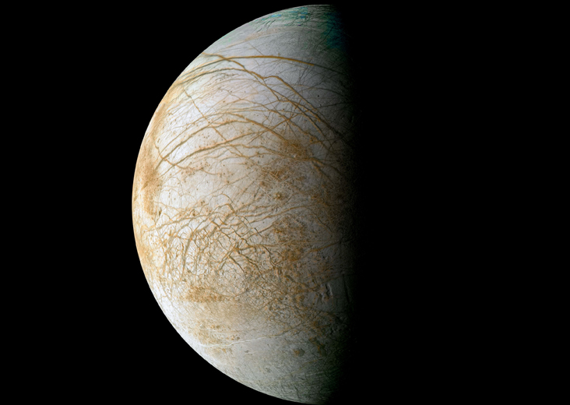
2. TYPES OF SATELLITES
8. Space Exploration Satellites
Europa, one of the 79 Moons of Jupiter

Slide 37
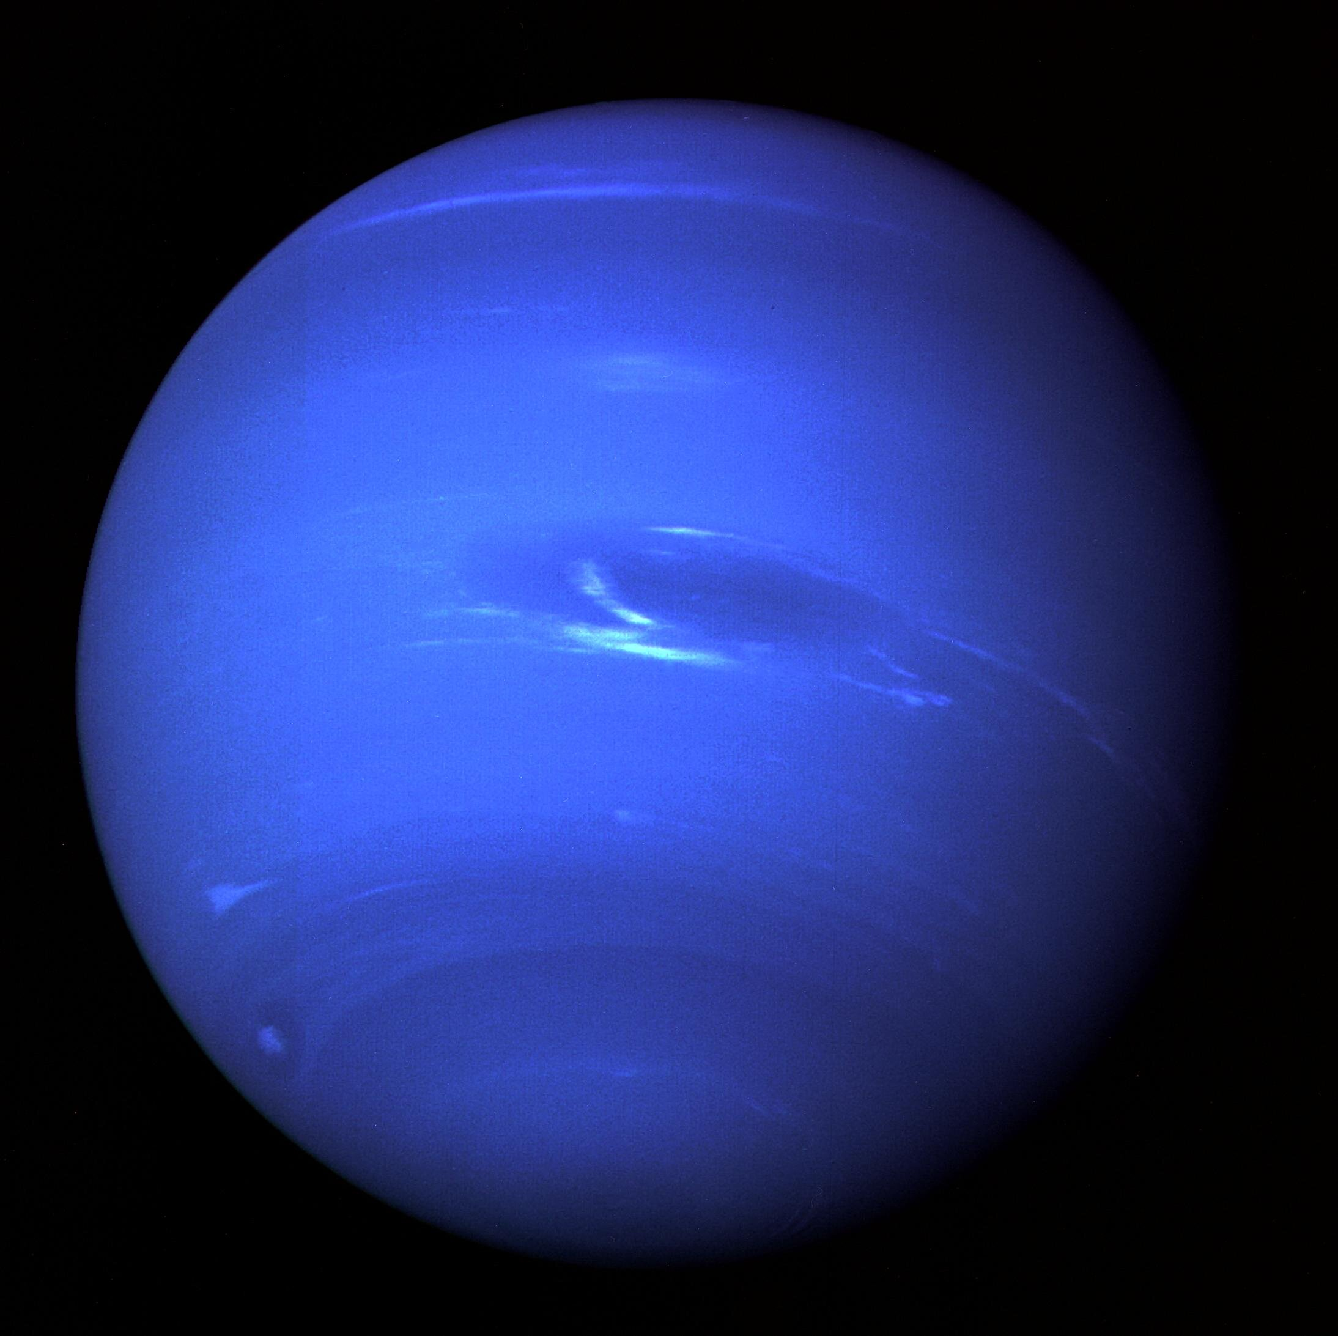
2. TYPES OF SATELLITES
8. Space
Exploration
Satellites
Neptune by Voyager 1

Slide 38
2. TYPES OF SATELLITES
9. Weather Satellites
Weather information all day long
Transmit series of photographs from these satellites can be displayed in sequence to produce a movie showing cloud movement

Slide 39
2. TYPES OF SATELLITES
9. Weather Satellites
Watch the progress of large weather systems such as fronts, storms, and hurricanes
Pass north to south poles as the Earth rotates to the east beneath the satellite

Slide 40
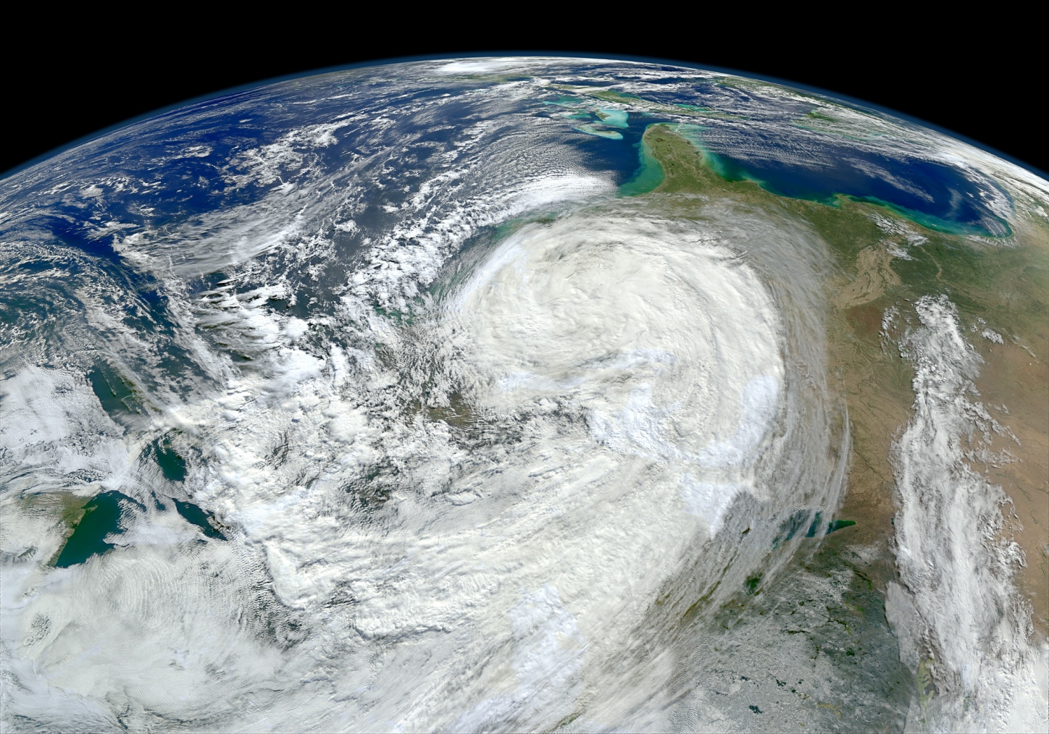
2. TYPES OF SATELLITES
9. Weather Satellites

Slide 41
Summary
Introduction
Types of Satellites
Astronomy Satellites
Atmospheric studies Satellites
Communication Satellites
Navigation Satellites
Reconnaissance Satellites
Remote sensing Satellites
Search and Rescue Satellites
Space Exploration Satellites
Weather Satellites

